Slide 1
Analyzing How Blood Pressure Changes with Age Across U.S. Adults
ASABERE ASANTE
MPH/MBA

Slide 2
TASK
What is the association between age and blood pressure?
Does the association vary by the following factors:
Sex
Race
Income
Insurance

Slide 3
STUDY POPULATION
Analysis was restricted to adult participants (Age > 18 years)
Income was defined as
IPR < 1 – Low Income
IPR >= 1 & < 4 – Middle Income
IPR > 4 – High Income

Slide 4
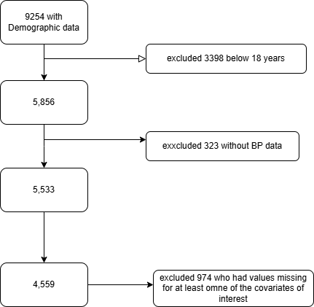
STUDY POPULATION

Slide 5
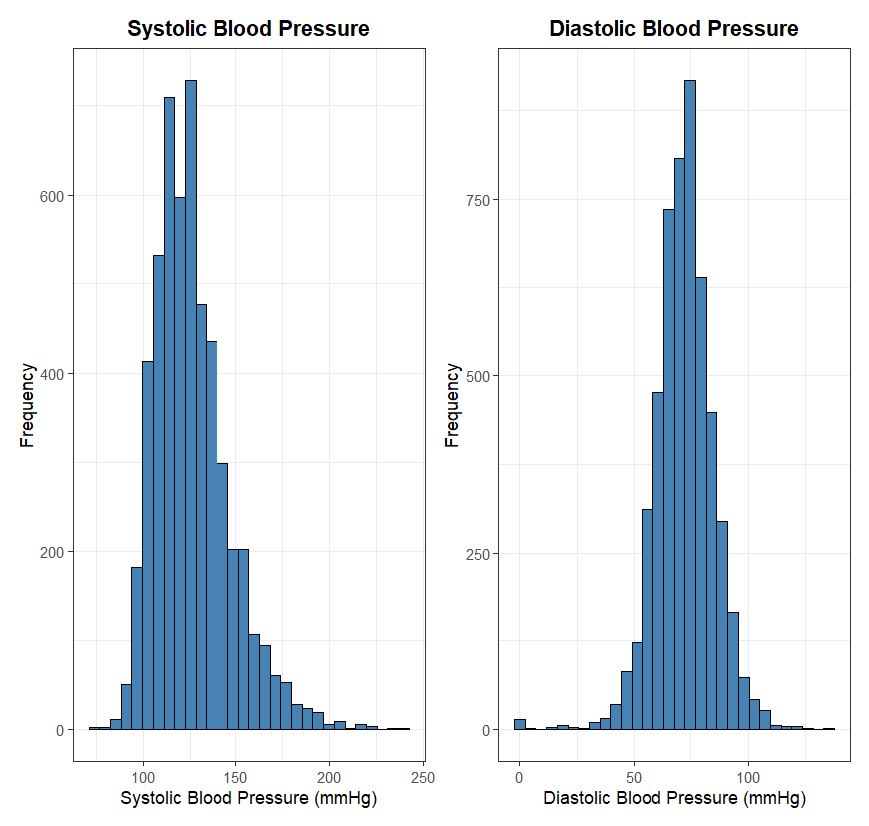

Slide 6
DISTRIBUTION OF SYSTOLIC AND DIASTOLIC BP
SBP shows a right-skewed distribution, with:
A clear mode around 120–130 mmHg
A long tail extending past 200 mmHg
This suggests a range of individuals from normotensive to hypertensive, with some high outliers.
DBP
has a more symmetric, bell-shaped distribution, peaking around 70–80 mmHg
Appears to follow a near-normal distribution, unlike SBP
Fewer extreme values compared to SBP

Slide 7
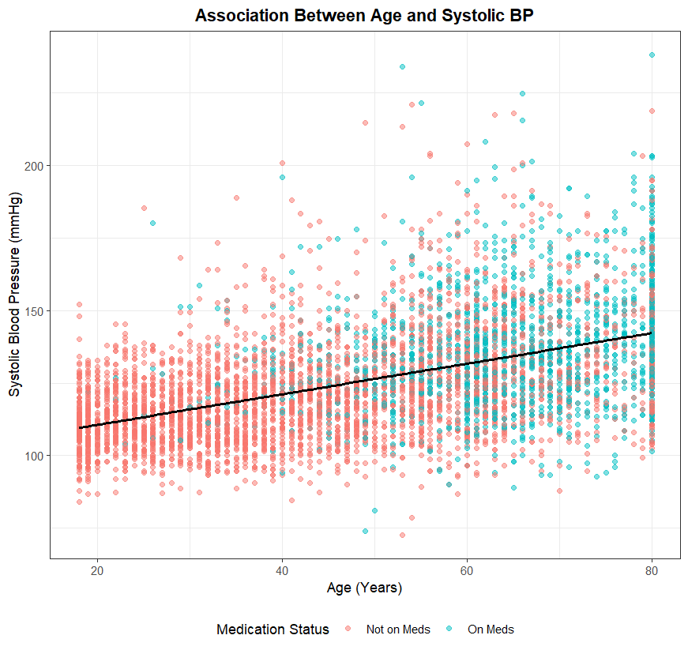

Slide 8
Initial EDA: Age, Systolic BP, and Antihypertensive Medication Status
There is a positive linear trend
SBP increases with age on average
People on antihypertensives tend to cluster towards higher SBP and older age

Slide 9
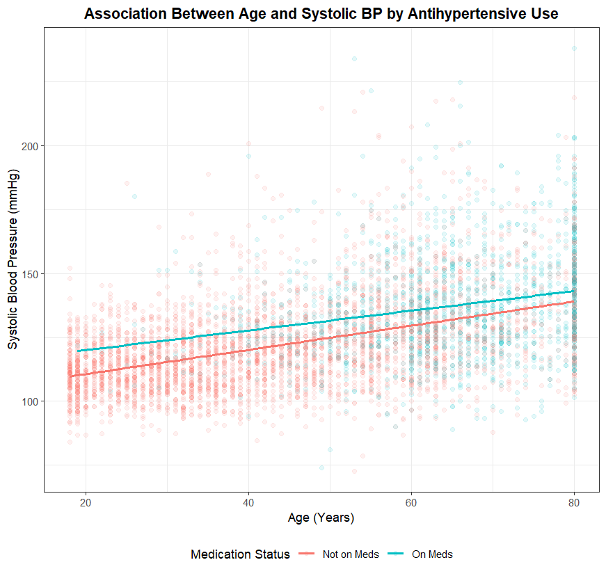

Slide 10
Initial EDA: Age, Systolic BP, and Antihypertensive Medication Status
SBP increase with age in both groups
Those on antihypertensives have higher SBP across most ages despite treatment
Higher BP among those on antihypertensives likely due to indication
The slopes look fairly parallel suggesting similar age-related increases in SBP regardless of treatment .
Starting SBP however differs

Slide 11
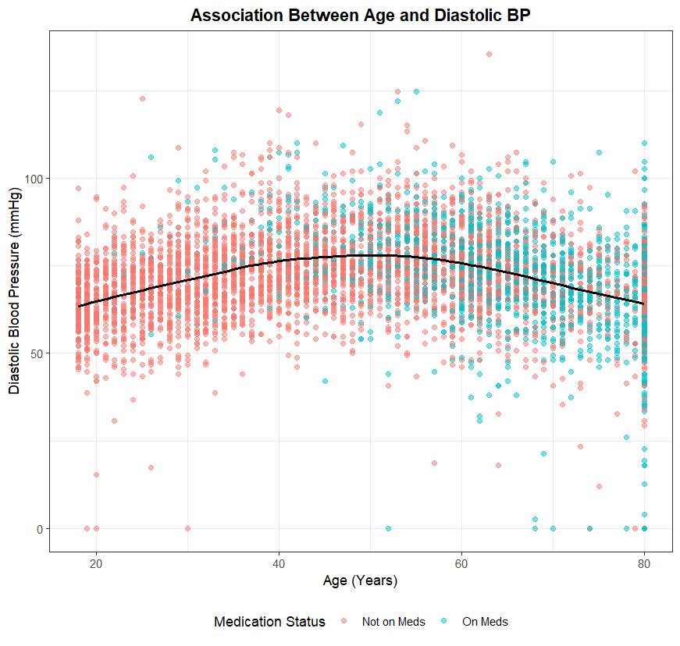

Slide 12
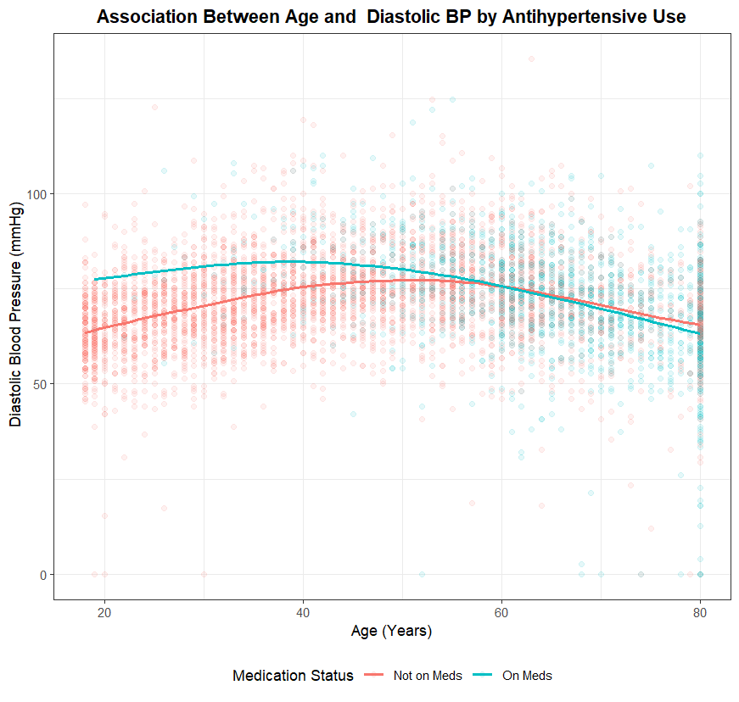

Slide 13
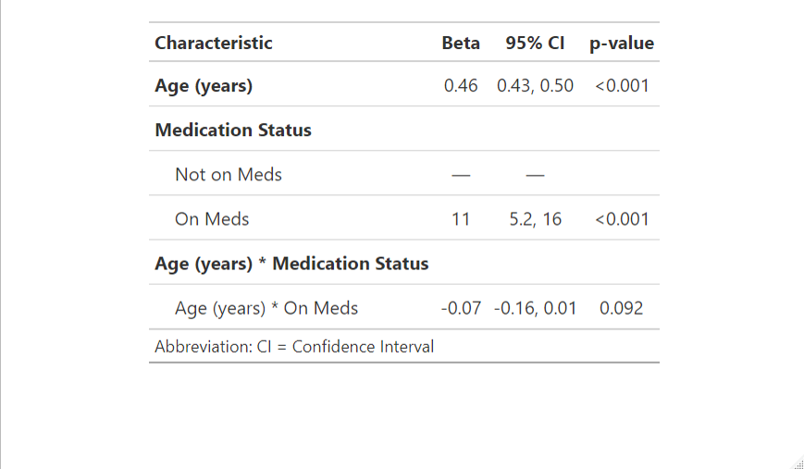

Slide 14
Age, Systolic BP, and Antihypertensive Medication Status
The interaction term was not statistically significant
Indicates that the slope of the Age-SBP relationship did not differ meaningfully by medication status
Participants on and off medication can be pooled while adjusting for medication status in the model
This allows for a common slope while adjusting for group differences in intercept

Slide 15
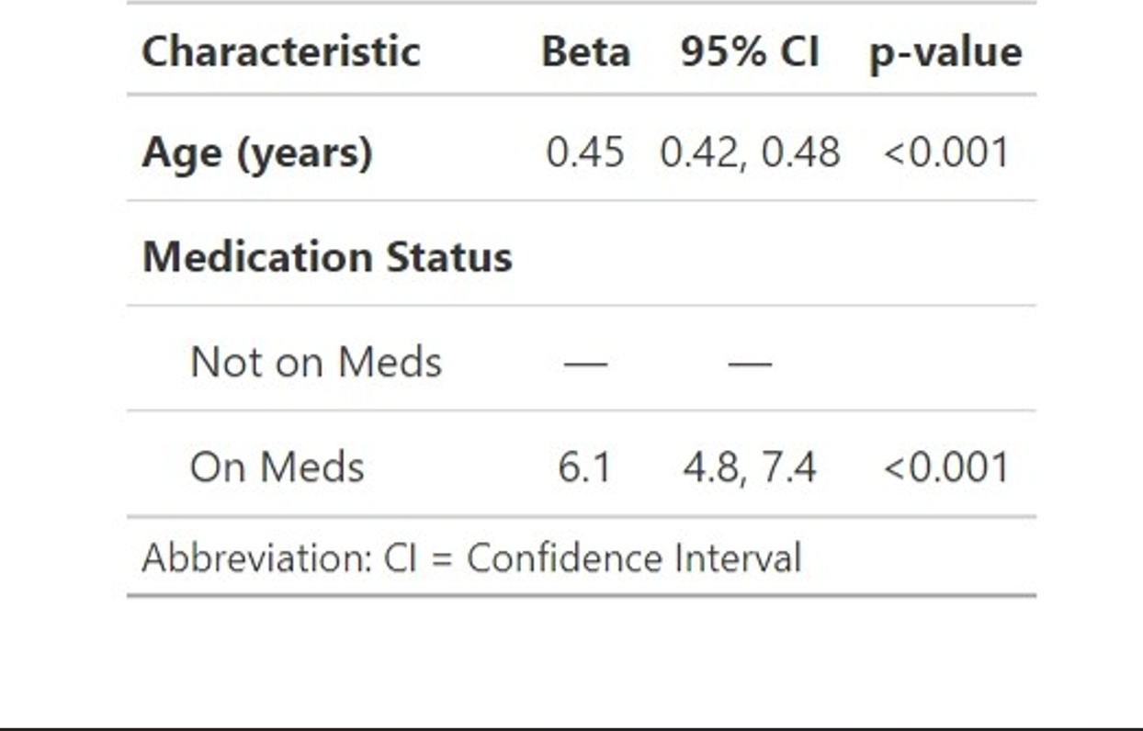
RELATIONSHIP BETWEEN AGE AND SYSTOLIC BP

Slide 16
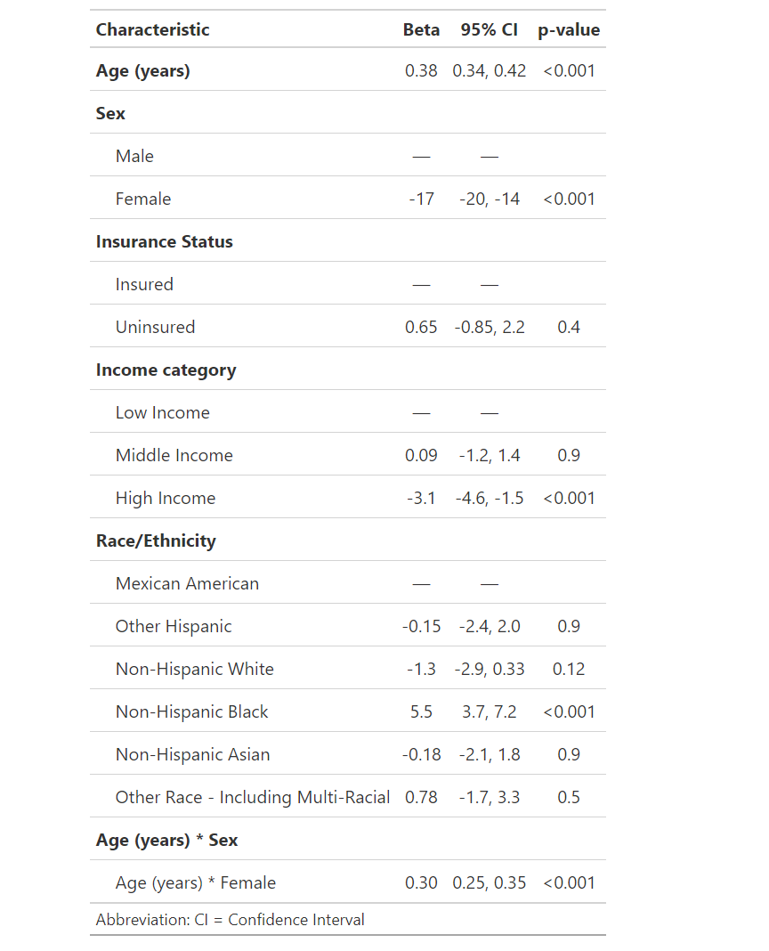

Slide 17
Sex Differences in the Age-Related Increase of Systolic Blood Pressure
For males, SBP increases by about 0.38 mmHg/year.
For females, SBP increases more steeply — about 0.68 mmHg/year.
This difference is statistically significant (p < 0.001), showing that age-related increases in blood pressure are stronger among females in this dataset.

Slide 18
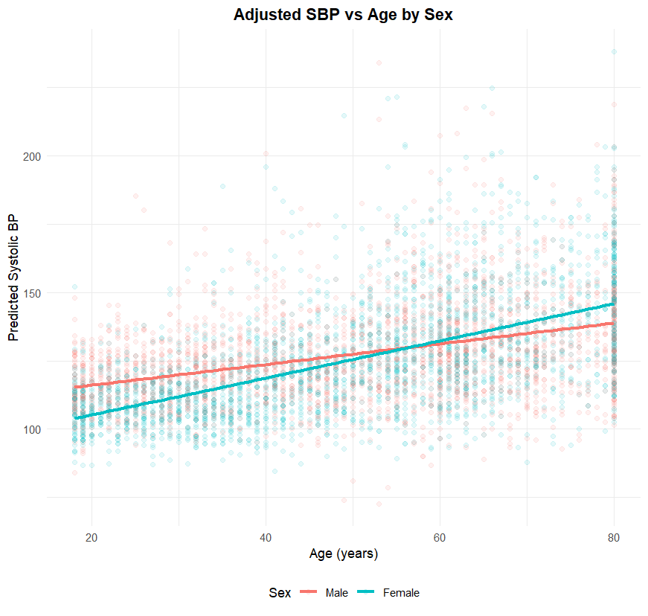

Slide 19
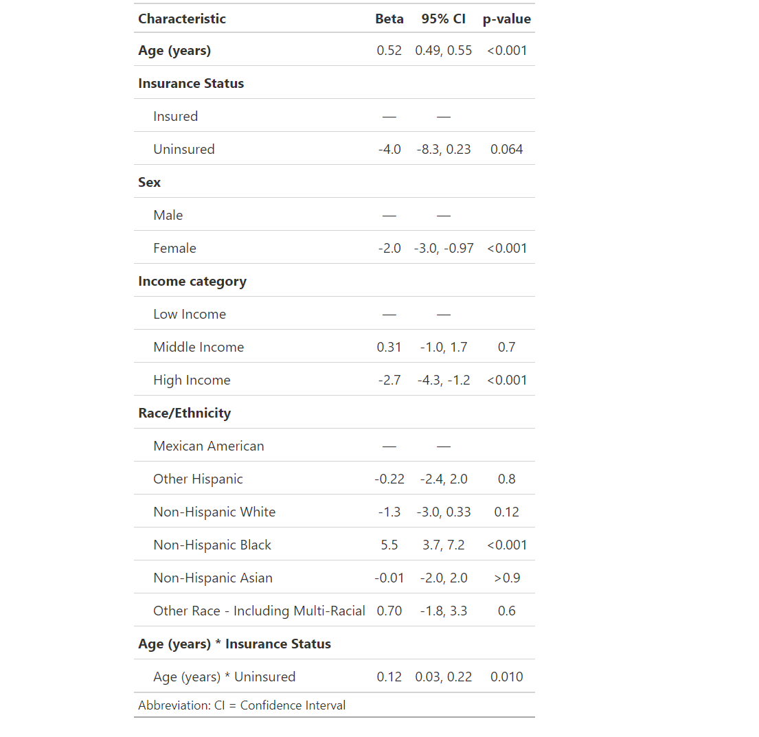

Slide 20
Age-Related Increases in Blood Pressure Are Steeper Among the Uninsured
Average SBP does not significantly differ between insured and uninsured individuals overall (p = 0.064)
For insured individuals: SBP increases with age at a rate of 0.52 mmHg per year
For uninsured individuals: The rate of increase is 0.52 + 0.12 = 0.64 mmHg per year
So, SBP rises more steeply with age among the uninsured than the insured
This suggests that the gap in blood pressure may widen with age among those without insurance.

Slide 21
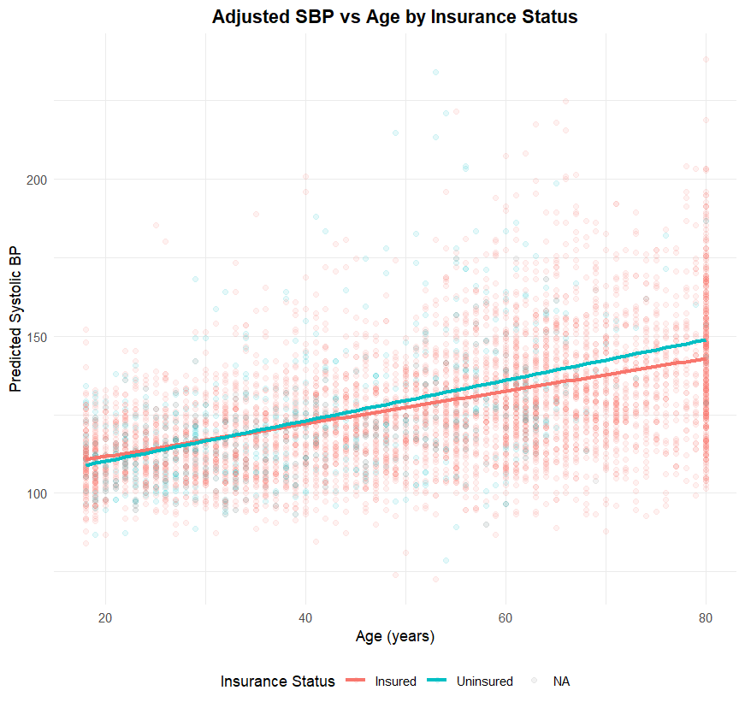

Slide 22
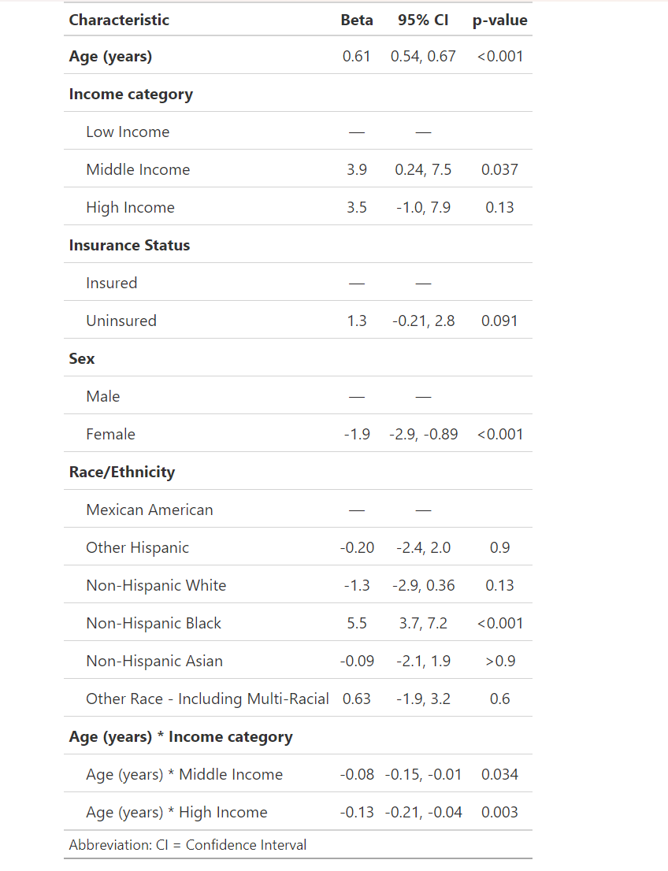

Slide 23
Variation in Age-Related Blood Pressure Trends by Income Level
Average systolic BP was significantly higher among middle-income individuals compared to low-income individuals (β = 3.9 mmHg, p = 0.037)
High-income individuals also had higher average SBP, though not statistically significant (β = 3.5 mmHg, p = 0.13)
Systolic blood pressure increases with age in all income groups, but:
The rate of increase is significantly slower in middle- and high-income groups compared to the low-income group.
This implies that while higher-income groups start with slightly higher SBP, their age-related increase is more gradual, leading to potential crossover or convergence at older ages

Slide 24
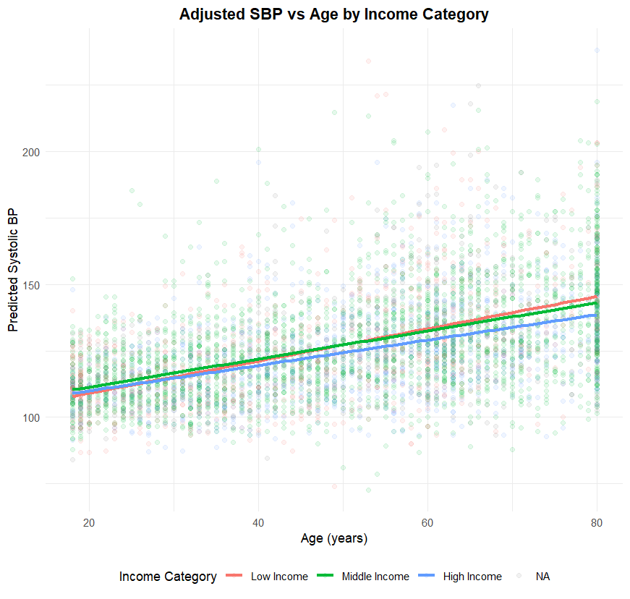

Slide 25
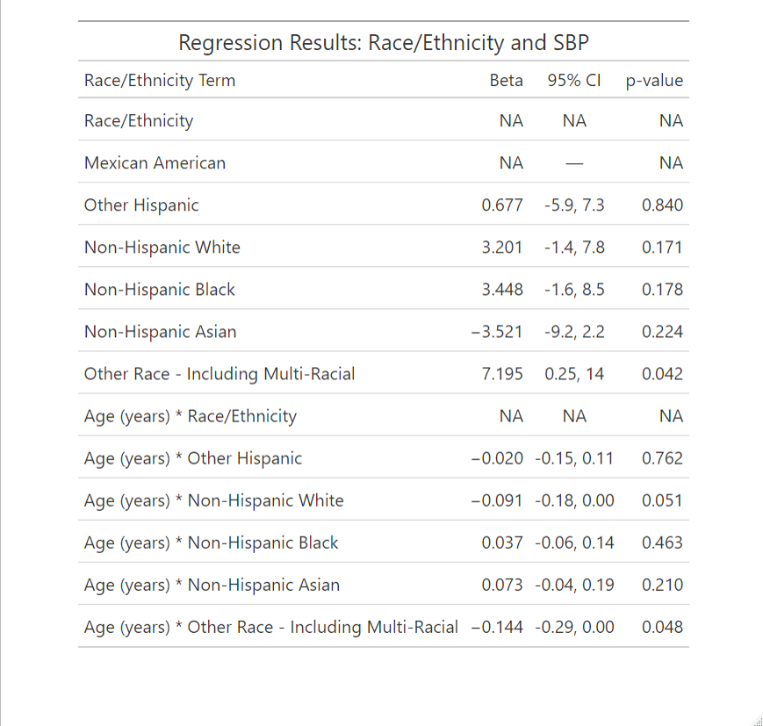

Slide 26
Age-Related Trends in Systolic Blood Pressure by Race/Ethnicity
Among racial/ethnic groups, only individuals classified as "Other Race - Including Multi-Racial" had significantly higher average SBP and a significantly flatter age-related slope compared to Mexican Americans.
All other differences were not statistically significant after adjustment.

Slide 27
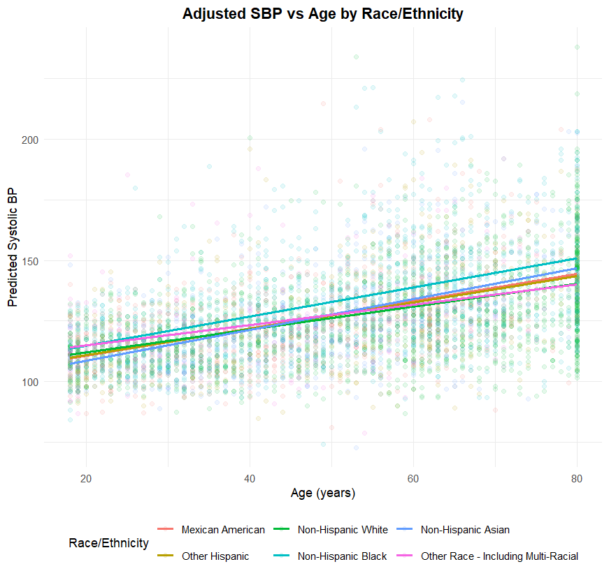

Slide 28
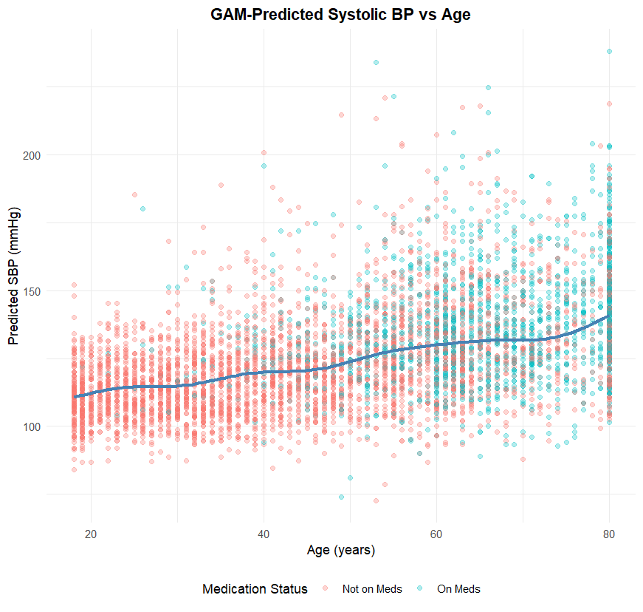

Slide 29
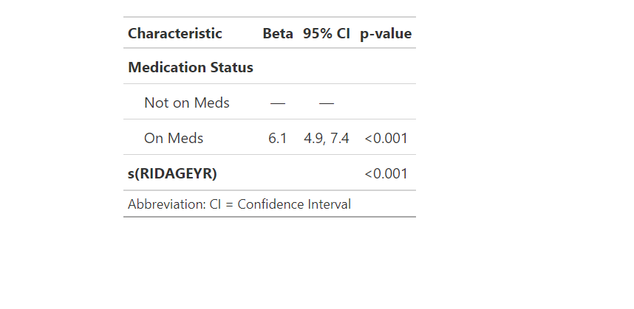
GENERALIZED ADDITIVE MODEL

Slide 30
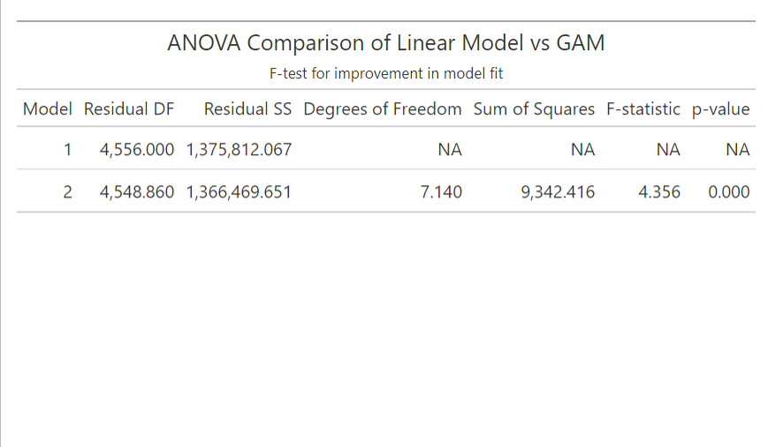
ANOVA COMPARISON OF LINEAR MODEL VS GAM

Slide 31
GAM Reveals Non-Linear Relationship Between Age and SBP
The spline for age (s(RIDAGEYR)) is highly significant (p < 0.001), which supports the nonlinear effect of age on SBP.
This means that age likely influences SBP at varying rates, not just linearly, which the GAM is able to capture.
The F-test is highly significant (p < 0.001), indicating that allowing for a non-linear (smooth) effect of age improves model fit
The GAM model explains significantly more variance than the linear model.

Slide 32
Thank You!

